Slide 1
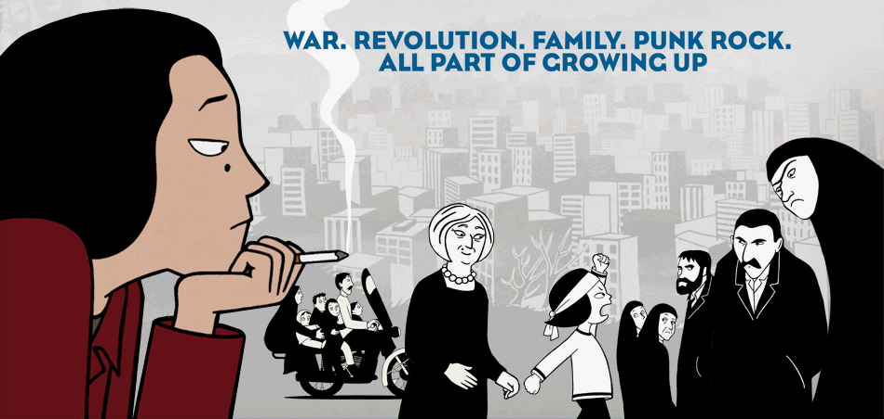
Characters Analysis - Persepolis

Slide 2
Instructions
Today we will be deeply analyzing the some characterization in chapters 2-5 of Persepolis.
Work with a group of 4 to do each of the following:
1. Successfully analyze a character with the use of the character analysis chart.
2. Develop a presentation of your character chart with the giant Post-It note.
3. Deliver the presentation as a whole group at the front. All group members need to have a role.

Slide 3
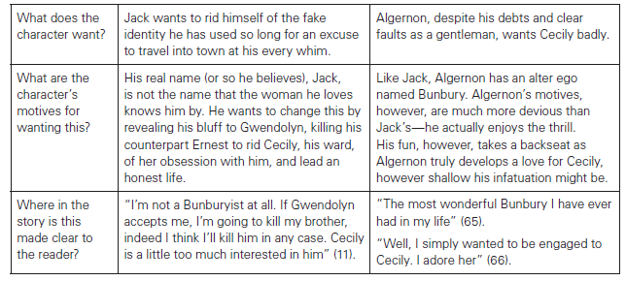
Character Analysis Chart

Slide 4
Whole-Class Discussion:
Connect that character’s description/development to the overall theme of these first few chapters.

Slide 5
Characters
1. Marji
2. Her Mom
3. Her Dad
4. Her Grandma/Grandpa
5. The Revolutionaries
6. The city/country/environment

